Slide 1
Personal Information- Management
Created by: Brainvire Ltd P.I.m department

Slide 2
What will be discussed:
General information
What programs
Database creation
Pro’s
Con’s
What is your job
GUI

Slide 3
General information
We are BrainvireLtd | P. I. M Department
Database
GUI
Send and receive

Slide 4
What programs?
Python 3.7
PyCharm
SQLite

Slide 5
Database
M:n
∞:1
Account
ID *
Name
Age
Etc..
Payroll
ID *
Purch..
ID *
Ufix Ltd database
Multiple tables
calendar
ID *
CRM
ID *
Etc…

Slide 6
Pro’s
Organized
Efficient
SELECT expressions FROM tables [WHERE conditions];
SELECT * FROM tables [WHERE conditions];

Slide 7
Con’s
Harder
More time

Slide 8
What is your job?
Own table
Primary key only

Slide 9
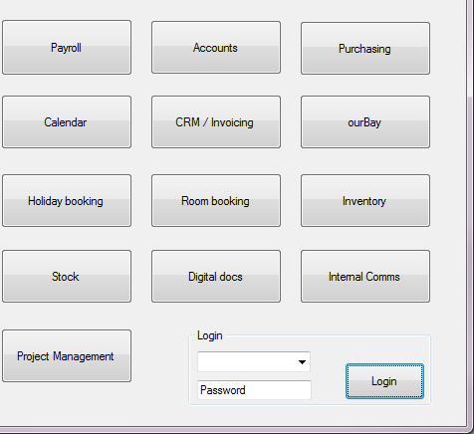
Graphical User Interface
Our vision
Login
Own data

Slide 10

Questions?
Danny Keijser
Alvaryn Dias
Josh King

